Slide 1

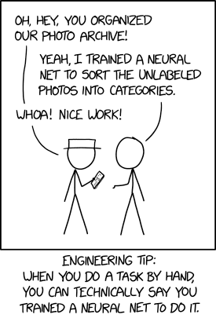
Artificial Neural Networks (ANNs)
Gosztolya Gábor
University of Szeged
Institute of Informatics
2023 / Apr / 27

Slide 2
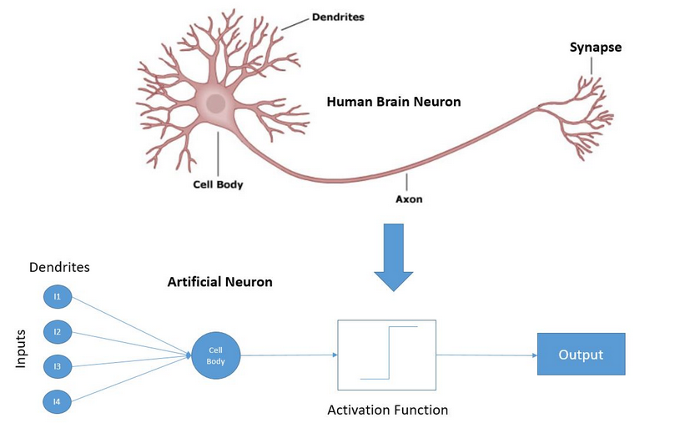
The neuron model
The most popular neuron model is the “perceptron”
Invented by Rosenblatt in 1957
He argued that the model behaves similarly to biological neurons
  Many inputs – “dendrites”
  One output – “axon”
  When the (weighted) sum of the
  stimuli reaches a threshold,
  the neuron fires, otherwise not
  The output of the neuron is binary
  (in the original model), this is the
  purpose of the activation function

Slide 3
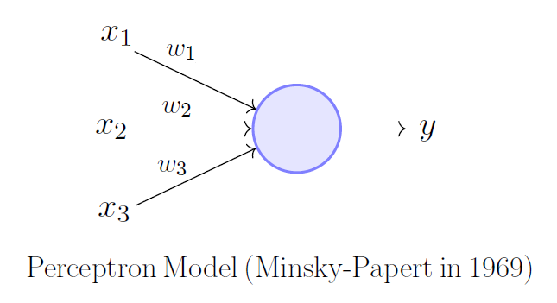
The “perceptron” neural model
The inputs correspond to the x₁…x_{n} features
The strength of the connections is modelled by the w₁,..,w_{n} weights
There is an additional w₀ „bias” parameter
The overall activation of the neuron is calculated as:
Or, using a fixed input x₀=1 :

Slide 4
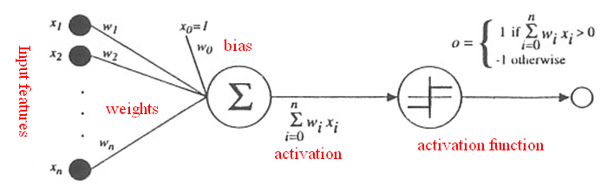
Activation in the perceptron model
So the overall activation of the neuron is:
The a activation is converted into the output o(a) by the activation function
In the original model this performs a simple thresholding:
The parameters to be learned are the w₁,..,w_{n} weights
  The perceptron model is practically a linear classifier

Slide 5
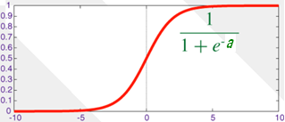
The sigmoid activation function
There were several strategies to train a linear classifier
Let’s use the sigmoid function as the activation function
  So the σ activation function and the output is:
We called this the logistic regression model earlier
  We also showed that it can be trained using the gradient descent algorithm
  By minimizing either the cross-entropy or the MSE error function

Slide 6
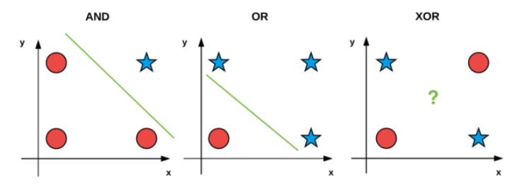
The representation power of one neuron
The perceptron model is equivalent to a linear classifier
In practice, very few tasks can be solved by a simple linear classifier…
Minsky és Papert showed in 1969(!) that AND, OR can be learned by one neuron, but the XOR operation cannot be represented
Research of the neural model was neglected until the early 80’s
  This time period is known as the first “AI winter”

Slide 7
Detour – AI winters
”a period of reduced funding and interest in artificial intelligence research” (a „nuclear winter” analógiájára) (Wiki)
  Too big funding → too big expectations → disappointment in AI → the funding practically ceases to exist
1966: The ALPAC report
  Russian → English automatic translation
  Machine translation is slower, more expensive and of worse quality than to hire a translation agency
  „The FTD machine-translation facility currently has a staff of 43 persons, including the posteditors. Their final product is 100,000 words of poor translation per day. Since JPRS could do the same amount of translation faster and for less than half the price, the Committee is at a loss to understand why the FTD does not rely on the services of the JPRS.”

Slide 8
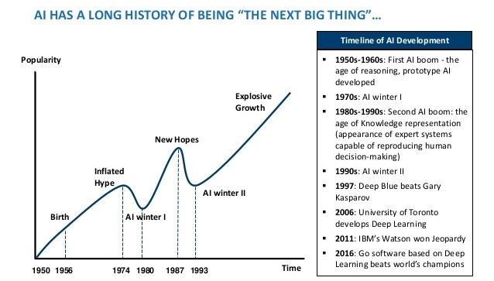
Detour – AI winters
1973: Lighthill report
  „In no part of the field have the discoveries made so far produced the major impact that was then promised”
  It „formed the basis for the decision by the British government to end support for AI research in most British universities”
1974-1980 (first AI winter)
  DARPA: „Defense Advanced Research Projects Agency” funded lots of projects (e.g. „autonomous tanks”, speech recognition), then cut funding in 1973

Slide 9
Detour – AI winters
1987-1993 (second AI winter)
  Collapse of the LISP machines (because of e.g. SUN workstations)
  Disappointment in the “expert systems”
1983-: Strategic Computing Initiative
  Actually DARPA, just using another organization
  1987: significant funding cuts

Slide 10
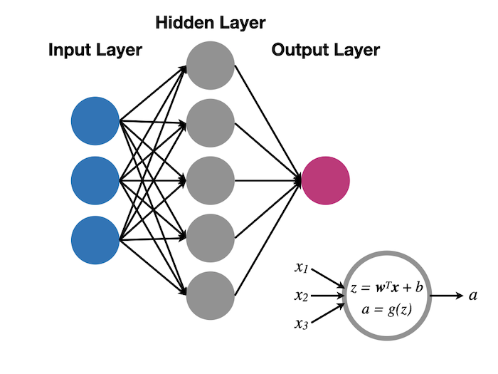
Neural networks
So it is easy to fully train a perceptron, but it cannot really learn complex relations…
How to increase the power of the model? Let’s build a network!
The outputs of one layer form the inputs of the subsequent layer
  Mathematically this corresponds to embedding functions into each other
Classic architecture: multilayer feed-forward network (fully conn.)
  Each layer receives it’s input from the previous layer
  The layers are „fully connected”: each neuron
  is connected with each neuron
  Only feed-forward connections

Slide 11
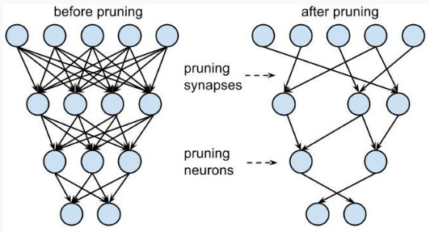
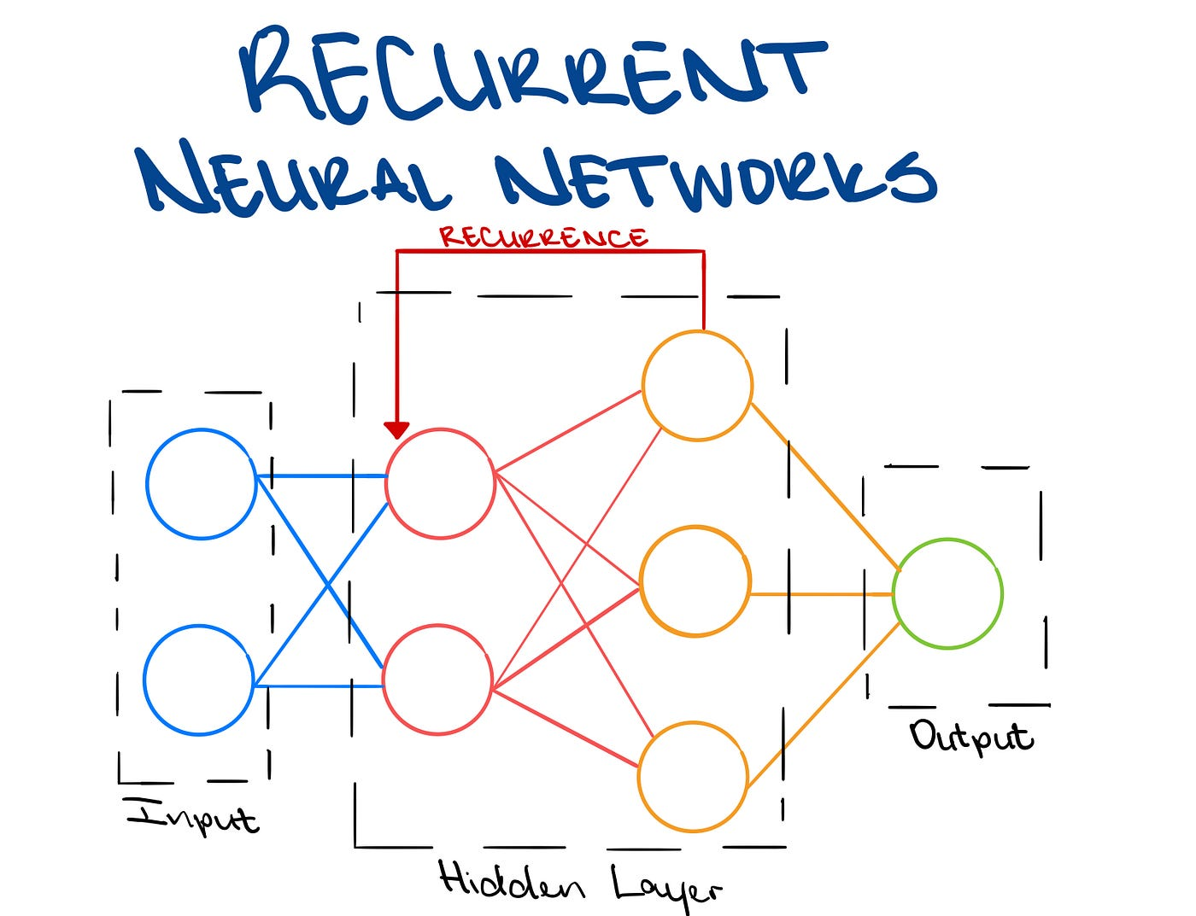
Alternatives to neural network structures
Relatively unusual, but:
  We may construct a “sparse” network instead of a fully connected one
  The connections may also skip layers
A recurrent structure is also viable, but it is much more difficult to train (→recurrent neural networks)
  In practice, these are mainly used to model time series

Slide 12
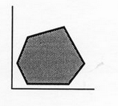
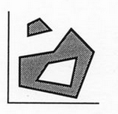
Representation power of a neural network
Separating a convex area: 1 hidden layer is enough
  Each neuron in the hidden layer corresponds to one
  boundary line
  The output neuron performs an AND operation: it fires
  where ALL the hidden neurons fire
Learning an arbitrary (non-convex, not connected) area: 2 hidden layers are enough
  Neurons in the first hidden layer correspond to lines
  Neurons in the second hidden layer perform AND
  operations to cover convex areas
  The output neuron connects these areas by an OR operation into non-convex, non-continuous regions

Slide 13
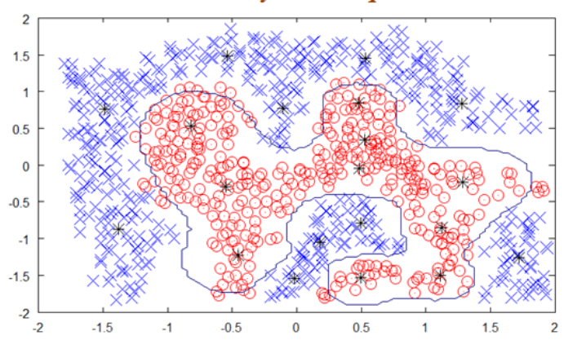
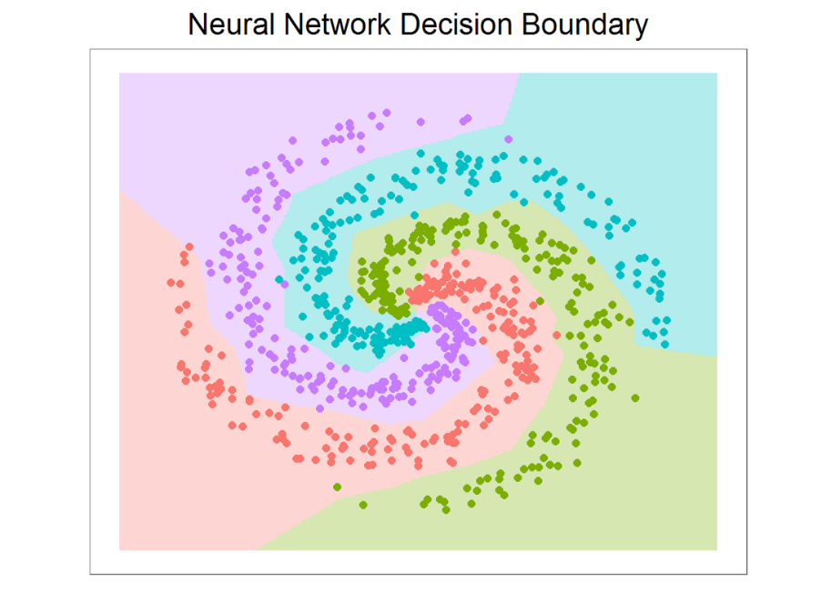
Representation power of a neural network #2
Theoretically any practical learning task can be solved by a neural network with only two hidden layers
Assuming that we have:
  an infinite amount of training data,
  infinite number of neurons,
  and a training algorithm which guarantees global optimum…

Slide 14
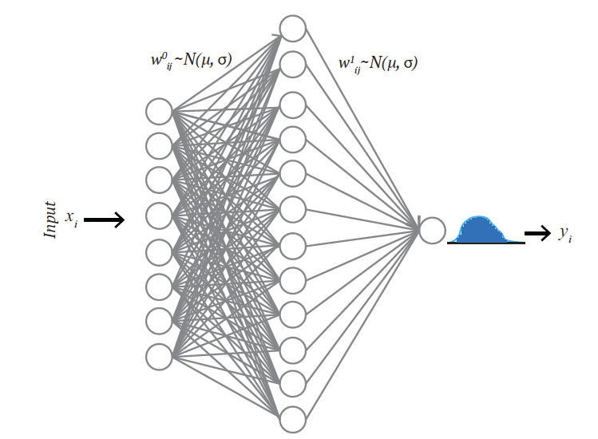
Connection with statistical pattern recognition
The previous slide showed how can a network separate the classes
  → geometrical view
But it can also be showed that the operation of the network also can be interpreted by the decision theoretic view
  Under certain conditions
To do this, we focus on the output layer

Slide 15
Connection with statistical pattern recognition #2
We assign an output neuron to each c_{i} class
  We expect these to approximate the posterior P(c_{i}|x) of the given class
Using the outputs, we classify a given input using Bayes’ decision rule
  We select class c_{i} with the largest P(c_{i}|x) output value
The proof that ANNs can approximate the P(c_{i}|x) values (required by Bayes’ decision) increased their popularity in certain areas
Knowing the P(c_{i}|x) probabilities can be used not only for classification, but also for several other purposes
  E.g. as a confidence measue of how much the given output is reliable

Slide 16
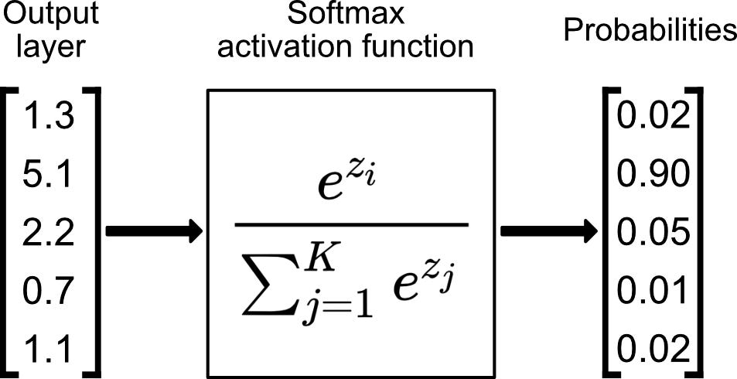
The network output as a probability distribution
What are the requirements for the network outputs to approximate the P(c_{i}|x) posterior probabilities?
There should be an output neuron assigned to each c_{i} class
  We expect these to approximate P(c_{i}|x)
We apply the softmax activation function for the output neurons
  All outputs fall in the [0,1] range,
  with their sum being 1 (see linear machine!)
  In some cases it can be proven that these
  really approximate the P(c_{i}|x) posterior values

Slide 17

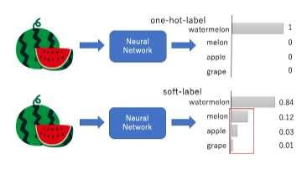
Training using softmax
The training labels should form an 1-of-M encoded vector
  It is an M sized vector (M is the number of classes), which contains only one 1:
As the error function, use either the MSE or the cross-entropy error
And don’t forget that in practice you will get only an estimate of the P(c_{i}|x) distribution!
  For an exact estimate, you would need infinitely many neurons, infinitely many training samples, and a perfect training algorithm

Slide 18
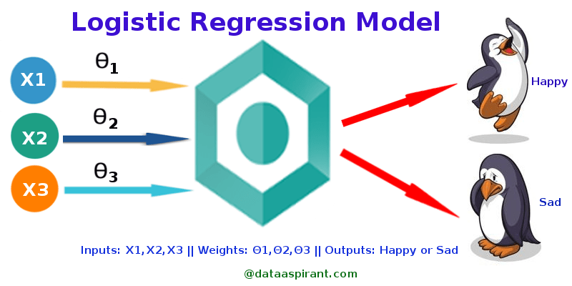
Training the neural network
A ”network” consisting of just one neuron is equivalent with the logistic regression model presented earlier
We also saw that we can train this model using the gradient descent algorithm
  Using either the MSE or CE error function
In the multi-class case we put one neuron for each class in the output layer
  In this case we can apply multi-class logistic regression (also presented earlier)

Slide 19
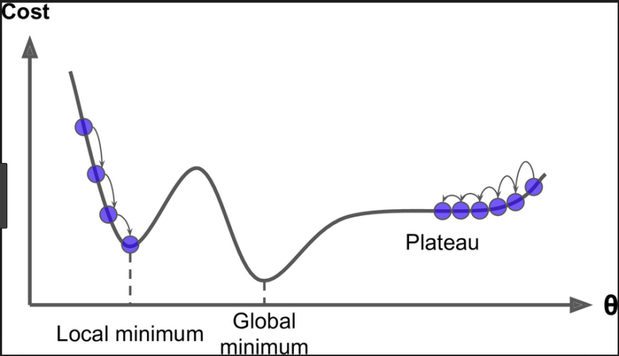
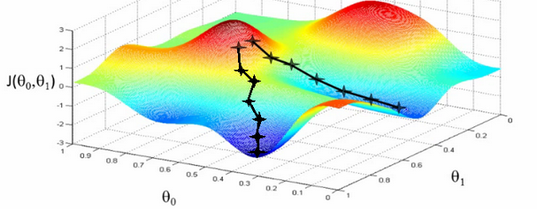
Gradient descent (recap)
A variant of the „hill climbing” algorithm
  The gradient helps us find the direction of where to move on
  The steepest descent principle tells us to move in an opposite direction with the gradient
We start from a random initial point
  The method is iterative (we go on until we get stuck)
  Generally only a local optimum is guaranteed to be found

Slide 20
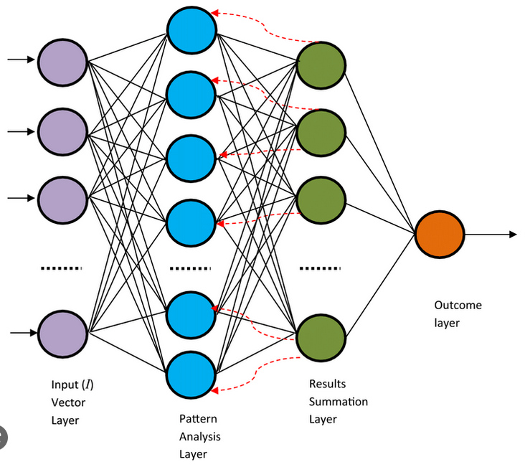
Training the neural network #2
The real novelty here is when we build a multi-layer network
In this case the output of the lower layers form the input of the upper layers
  This mathematically corresponds to a function embedding
The gradient descent algorithm is still applicable, but the error must be propagated back from the upper layers to the lower layers
  This is the so-called backpropagation algorithm

Slide 21
The backpropagation algorithm
Illustration for just one neuron, using the MSE cost function:
The dependency of E(w) from w_{i} is given by embedding these functions into each other
To calculate the derivative of these functions we use the chain rule

Slide 22
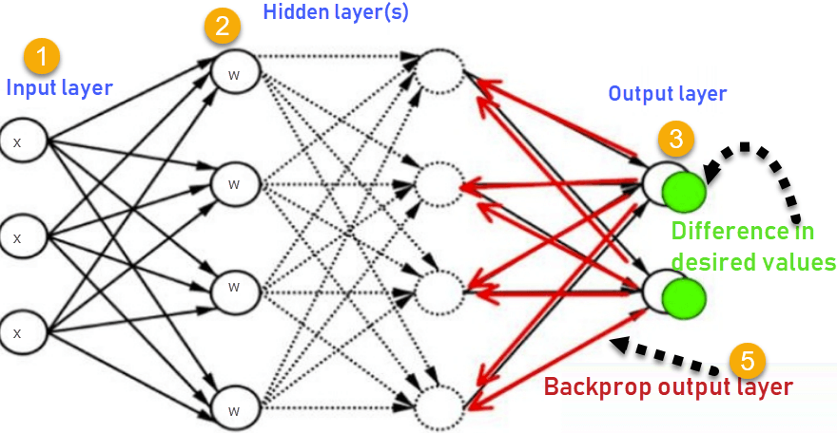
The backpropagation algorithm #2
Derivative: we use the chain rule
Update the weights in each step:
  Where η is a small positive constant („learn rate”, LR)

Slide 23
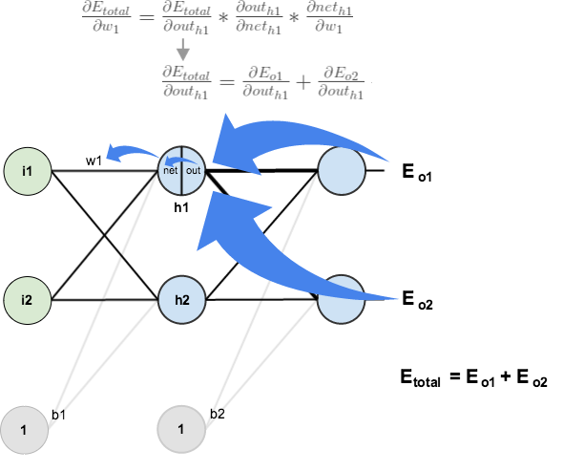
The backpropagation algorithm #3
General case: many output neurons,
multi-layer network
We have to apply the chain rule
as before, but for more steps
  The input of the output neurons is not x, but the layer underneath (in the derivation below, the sum over D is omitted for simplicity)
  The derivative (or shortly: “the error”) is first calculated for the output layer
  And then it is propagated back layer-by-layer to the lower layers

Slide 24
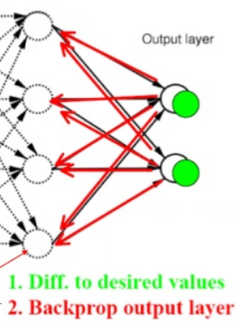
The backpropagation algorithm #4
The error of the k^{th} output:
The error of the h^{th} hidden unit
(backwards, layer-by-layer):
Interpretation: the error of a hidden neuron is proportional to the weighted sum of the errors of those neuron that use its output
  Where the weights are the weights of the given connection

Slide 25
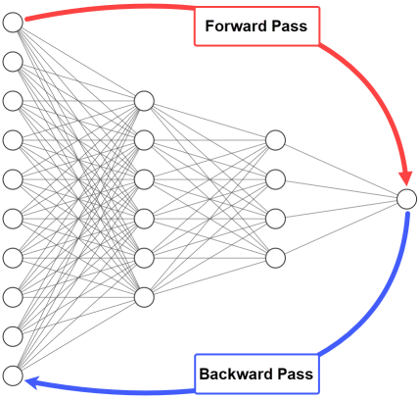
The backpropagation algorithm #5
In summary, the main steps of backpropagation training:
1) From the input to the output, we calculate the output of each neuron on the training set D
  To calculate the error we first need the outputs!
2) From the output to the input, we calculate the error of each neuron
3) We update the weights:

Slide 26
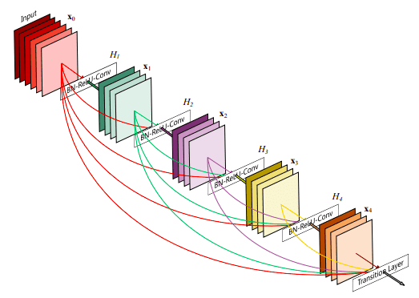
The backpropagation algorithm #6
Remark: The backpropagation algorithm also allows sparse structures, or the skipping of layers
The only requirement regarding the architecture is that is should not contain loops
  No loops → we can calculate the output and the error following a topological ordering
  In the case of loops in the graph we obtain a recurrent network – training these is much more complicated

Slide 27
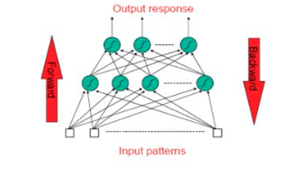
Stochastic backpropagation
The cost functions are defined as the
average error over all samples:
To evalute this we have to process all the data
  This prohibits online training
On-line backpropagation is when we omit the summation over D
  Instead of this, we perform the evaluation, backpropagation and weight update steps after receiving each sample

Slide 28
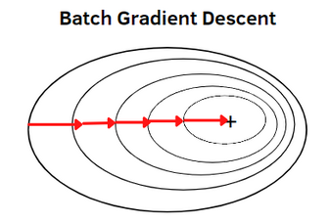
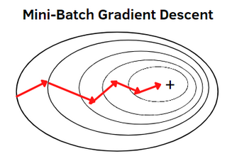
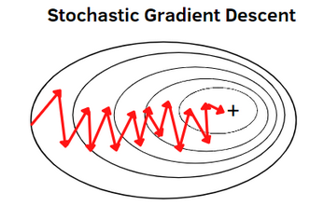
Batch backpropagation
Batch backpropagation: we update the weights after receiving a block or „batch” of data
In this case we optimize a different version of the cost function in each step!
  i.e. the error calculated over the given batch
Surprisingly, this is not harmful but beneficial: it introduces a small randomness in the system
  Which helps avoid local optima
This is why it is called “stochastic” gradient descent (SGD)

Slide 29
Batch backpropagation #2
The advantages of training in batches:
  Lower risk of getting stuck in local maxima
  Faster convergency of training
  On iteration is faster (no need to process all the data in each step)
  Implementation is easier (one batch of data fits in the memory)
  It allows for online or semi-online training
This is the most popular training scheme
The typical batch size is 10-100-1000 examples
As in the case of training on all the data, we usually go more rounds over the full data set
  One „round” on all the training data is known as a “training epoch”

Slide 30
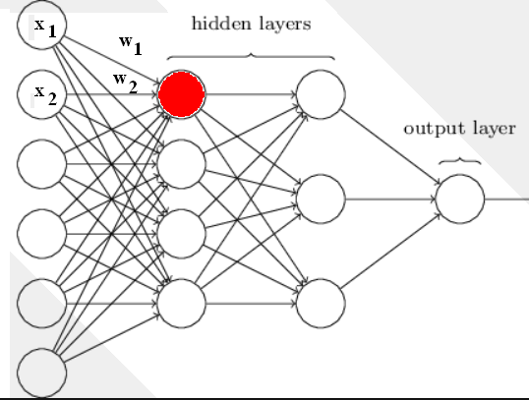
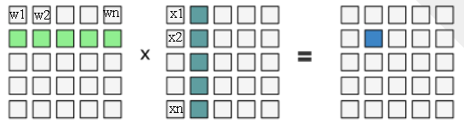
Batch backpropagation for GPUs
Why is it more efficient to train neural networks on GPUs?
Calculating the activation of one neuron:
=vector-vector multiplication
But the activations of the neurons of a given
layer can be calculated in a parallel manner!
=matrix-vector multiplication
And the above can be done in parallel
for a batch of input vectors!
=matrix-matrix multiplication
GPUs can calculate the components of a product matrix in a parallel manner – this is 30-40 times faster than using just one CPU

Slide 31
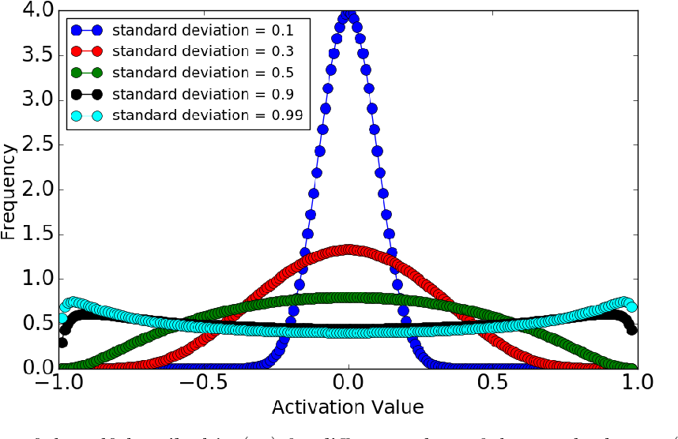
Weight initialization
The weights are initialized with small random values
  E.g. ones between -0.1 and 0.1
The initialization is particularly important for deep networks (i.e. those having many hidden layers)
  A good initialization strategy help propagating back the error even to the lowest layer
  There are multiple strategies for initialization, which might depend on the activation function used
  E.g.: let the weights be random numbers following a Gaussian distribution, mean=0, std: 1/#inputs

Slide 32
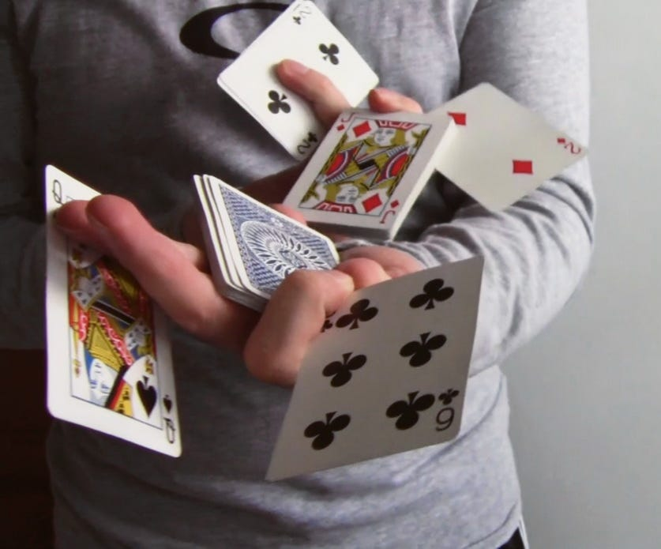
Shuffling the training data
During batch training it might be helpful to shuffle the training examples (order them in a random order)
  This is a must if e.g. the examples are not shuffled based on their class labels (e.g. first examples for class #1, then for class #2 etc.)
  It also helps if the class labels are shuffled, but there is some other property which is not shuffled (e.g. in speech recognition: the recordings are ordered by speakers)

Slide 33
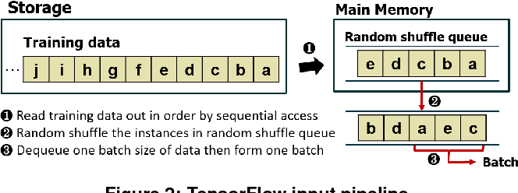
Shuffling the training data #2
Why does shuffling help?
  We always optimize the error for the current batch, so more recent examples are more important than older ones
  Therefore the network learns the special properties of the latter examples, and forgets the properties of the former examples
We have to iterate over the data several times
  So in theory it might worth to shuffle the data before each epoch
  Unfortunately, shuffling is quite
  cumbersome: if we do it in the memory,
  then data access will be slower; if we do it
  in files, then the whole process will be
  even more hard technically

Slide 34
Normalization of the training data
Before training it is worth to convert the range of the values of the different features
to the same scale
  min=-1, max=1: not so practical, one “outlier” might ruin it
  Standard solution: let the mean of each feature be 0, its std is 1
Why does such an uniform scaling help?
  The weights are initialized in the same range. If the range of the features would differ significantly, some features would suppress
  other features when calculating the activations, i.e.:
Fever | Joint_pain | Cough | Influenza
38.2 | Yes | None | Yes
36.7 | Yes | Dry | No
41.2 | No | Wet | Yes
38.5 | Yes | Dry | Yes
37.2 | No | None | No

Slide 35

Normalization of the training data #2
Why do we normalize to around 0?
Recall the sigmoid activation function:
If is too large or too small, then it falls to the “flat” region of the sigmoid
Here the derivative is close to 0, so the network will not learn (“vanishing gradient” problem)
  We will deal with this when discussing further activation functions and further regularization methods

Slide 36
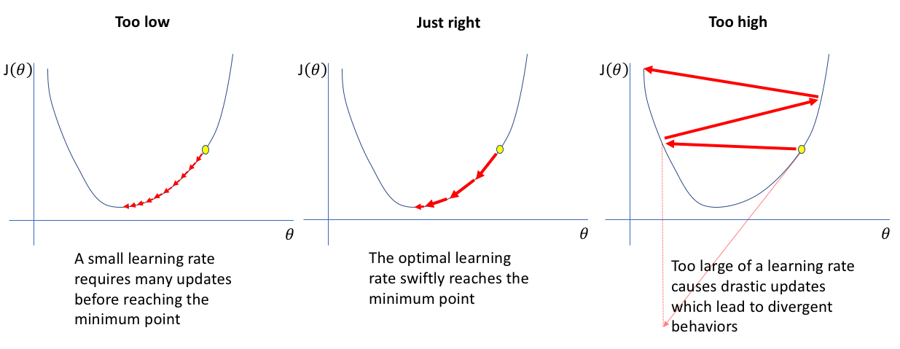
Setting the right learning rate
The learning rate (LR) is usually set based on experience
  Although there are attempts to set it automatically
  Too large LR: no learning, we just jump around on the error surface
  Too small LR: slow learning, easier to stuck in a local optimum
Standard general heuristic:
  Let’s start with such a large LR
  as possible (so where the
  network can still learn)
  After a while (when the error
  stops decreasing) lower the
  LR (e.g. dividing by 2)

